Slide 1
MYSQL PRESENTATION-LOAN MANGEMENT SYSTEM
PRESENTED BY
RAMYA. R

Slide 2
MY SQL
My SQL Stands for Structured Query Language.
MySQL is a popular open-source relational database management system(RDBMS).
MySQL supports structures query language.
MySQL is open-source software ,free to use and modify.

Slide 3
DBMS
DBMS stands for Database Management system.
A DBMS is a software system that allows you to define, create, maintain, and control access to database.
The purpose of a DBMS a way to store, orgnize and retrive data.

Slide 4
RDBMS
RDBMS stands for Relational Database Management System.
RDBMS stores data in a structured format using tables with rows and columns.
Each table represents a different entity, and each row in a table represents a unique record.

Slide 5
BENEFITS
Open-Source : MySQL is free to use and modify.
Security : MySQL has robust security features to protect data.
Cross-platform : MySQL runs on multiple OS like windows,linux,macOS.
High performance.
Easy to use.

Slide 6
SQL LANGUAGE STATEMENTS
Data Definition Language(DDL)
Table creation, alter add column, drop ,modify, change column, table rename.
Data Manipulation Language(DML)
Inserting values, update values, deleting values.
Data Query Language(DQL).
General function, Aggregate function, Logical function,
Date time function, String function, Join function.
Transaction Control Language(TCL)
Commit(save point), Roll back(undo changes).

Slide 7
DATA TYPES
Numeric Data types.
Date Time.
String.

Slide 8
NUMERIC
INT
It ranges from -2147483648 to 21474836470 to 4294967295 11 digits.
INT is a 4-byte data type, which means it can store values upto 4 bytes in size.

Slide 9
DATA TIME
DATA
It range from ‘1000-01-01’ to ‘9999-12-31’.
For example : Displayed as ‘yyyy-mm-dd’.
TIME
It range from ‘-838:59:59’ to ‘838:59:59’.
For example: Displayed as ‘HH:MM:SS’.

Slide 10
DATA TIME
TIMESTAMP DIFF
It range from ‘1970-01-01 00:00:01’ UTC to‘2038-01-19 03:14:07’ TC.
For exmaple : Displayed as ‘yyyy-mm-dd hh:MM:SS’.
YEAR
It range from 2 digits or 4 digits.
For example: Default is 4 digits.

Slide 11
STRING
VARCHAR
It is a data type used to store character strings of variable length.
It range from Maximum size of 255 characters.

Slide 12
PRIMARY KEY
A primary key is a column or set of columns in a table that uniquely identifies each row in the table.
It doesn’t allow duplicate values.
It is a way to identify each record in a table uniquely.

Slide 13
FOREIGN KEY
A foreign key is a column or set of columns in a table that references the primary key of another table.
It is a way to establish a relationship between two tables.

Slide 14
MY SQL MAIN COMMENTS
CREATE DATABASE
An SQL relation is defined using the CREATE DATABASE command:
create database [database name]
Example
create database mydatabase;
CREATE TABLE
Create table table_name;

Slide 15
TRIGGER
A database trigger is a stored program which is automatically fired or executed when some events occur.
TYPES OF TRIGGER:
Row Level Trigger- an event is triggered at row level for each row update,inserted or deleted(before insert).
Statement Level Trigger- an event is triggered at table level for each sql statement executed(after insert).

Slide 16
TRIGGER
Triggers timing
Before insert : pre-screening step that happens before data is modified.
After insert : post-screening step that happens after data is modified.

Slide 17
CREATE TABLE FOR LOAN_STATUS
create table loan_status(loan_id varchar(50), customer_id varchar(50),loan_amount int,loan_amount_term int,cibil_score int,primary key(customer_id));
alter table loan_status modify loan_amount varchar(50);
create table cibil_status(loan_id varchar(55), loan_amount varchar(55),cibil_score int,cibil_score_status int);
alter table cibil_status add primary key(loan_id);
alter table cibil_status modify cibil_score_status varchar(50);

Slide 18
ROW LEVEL TRIGGER
delimiter ##
create trigger loan_amount_status
before insert on loan_status
for each rowbegin
if new.loan_amount is null then
set new.loan_amount = 'loan still processing';
end if;
end ##
delimiter ;
show triggers;

Slide 19
STATEMENT LEVEL TRIGGER
delimiter ##
create trigger cibil_score_update after insert on loan_status for each row begin
if new.cibil_score>900 then insert into cibil_status(loan_id,loan_amount,cibil_score,cibil_score_status) values(new.loan_id,new.loan_amount,new.cibil_score,'high cibil score');
elseif new.cibil_score>750 then insert into cibil_status(loan_id,loan_amount,cibil_score,cibil_score_status) values(new.loan_id,new.loan_amount,new.cibil_score,'no penalty');
elseif new.cibil_score>250 then insert into cibil_status(loan_id,loan_amount,cibil_score,cibil_score_status) values(new.loan_id,new.loan_amount,new.cibil_score,'penalty customers');
elseif new.cibil_score <0 then insert into cibil_status(loan_id,loan_amount,cibil_score,cibil_score_status) values(new.loan_id,new.loan_amount,new.cibil_score,'reject customers');
end if;
end ##
delimiter ;

Slide 20
JOIN ALL THE 5 TABLES WITHOUT REPEATING THE FIELDS
select c.customer_name,c.gender,
c.age,c.married,c.education,c.self_employed,a.*,
b.loan_amount_term,b.cibil_score ,b.cibil_score_status,c.region_id, d.postal_code,d.segment,d.state,e.region from customer_interest_analysis a join loan_cibil_score_status b on a.customer_id=b.customer_id join customer_info c on a.customer_id=c.customer_id join country_state d on a.customer_id=d.customer_id join region_info e on d.region_id=e.region_id;

Slide 21
FIND THE MISMATCH DETAILS USING JOINS
select * from country_state a right join region_info b on a.region_id=b.region_id;
Filter high cibil score
select c.customer_name,c.gender, c.age,c.married,c.education,c.self_employed,a.*,b.loan_amount_term,b.cibil_score ,b.cibil_score_status,c.region_id, d.postal_code,d.segment,d.state,e.region from customer_interest_analysis a join loan_cibil_score_status b on a.customer_id=b.customer_id join customer_info c on a.customer_id=c.customer_id join country_state d on a.customer_id=d.customer_id join region_info e on d.region_id=e.region_id where b.cibil_score_status='high cibil score';

Slide 22
FILTER HOME OFFICE AND CORPORATE
select c.customer_name,c.gender, c.age,c.married,c.education,c.self_employed,a.*,b.loan_amount_term,b.cibil_score ,b.cibil_score_status,c.region_id, d.postal_code,d.segment,d.state,e.region from customer_interest_analysis a join loan_cibil_score_status b on a.customer_id=b.customer_id join customer_info c on a.customer_id=c.customer_id join country_state d on a.customer_id=d.customer_id join region_info e on d.region_id=e.region_id where segment in('home office','corporate');

Slide 23
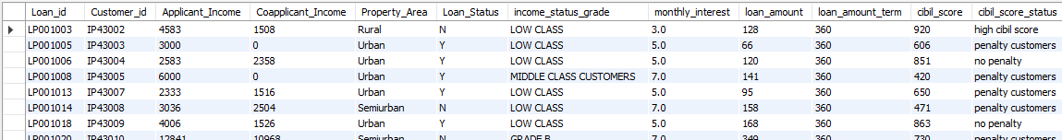
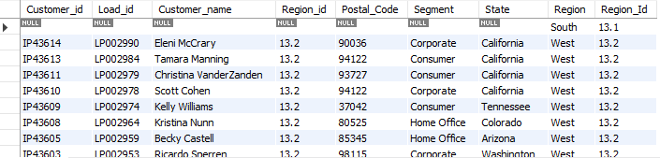
OUTPUT

Slide 24
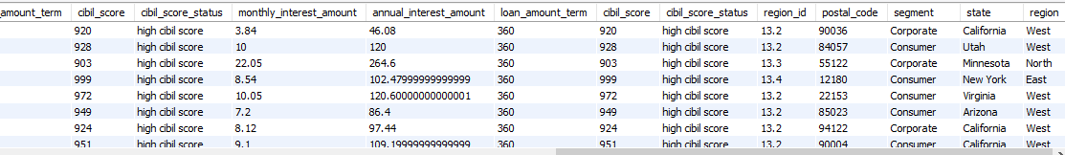
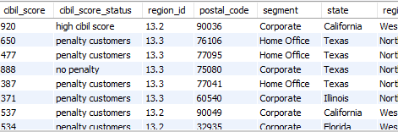
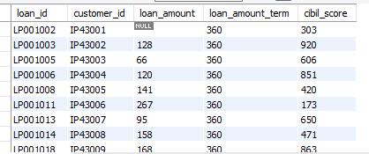

Slide 25
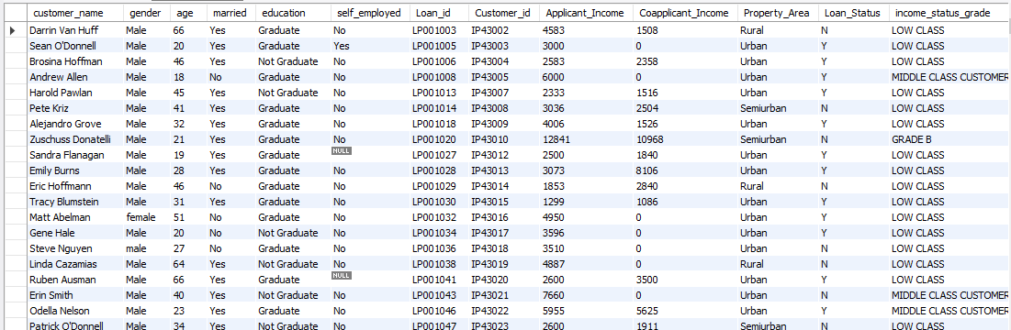
PROCEDURE OUTPUTS-RESULT 1

Slide 26
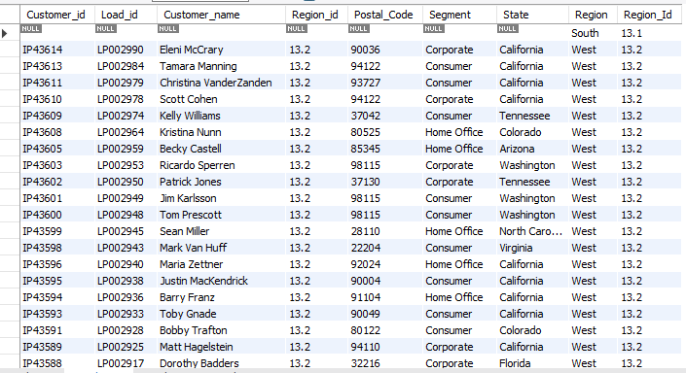
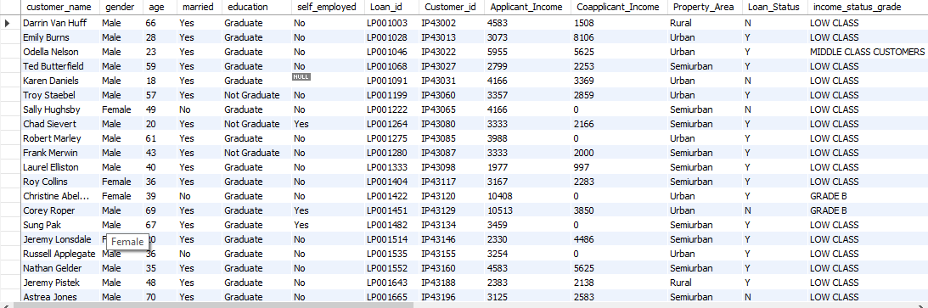
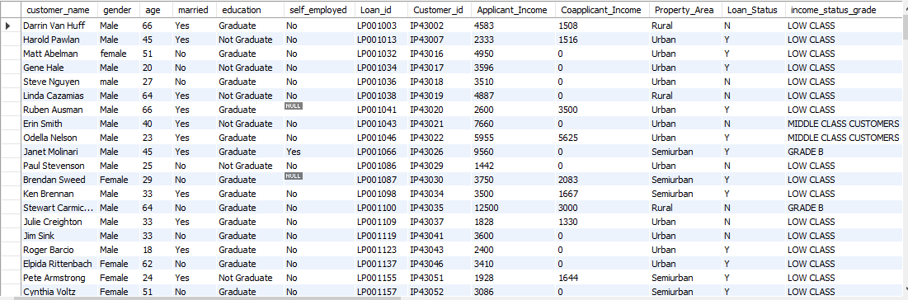
RESULT-2,3&4

Slide 27
THANKING YOU

